Slide 1

Intelligent Judicial Decision Support System
AI-Based Legal Decision Support

Slide 2
Problem Statement
Judicial systems face a growing number of cases. Manual case analysis is time-consuming and inconsistent. Judges need fast access to similar past cases and decisions.

Slide 3
Project Objective
Build an intelligent system to match new cases with similar historical cases. Support judges with data-driven insights. Improve consistency and efficiency in judicial decisions.

Slide 4
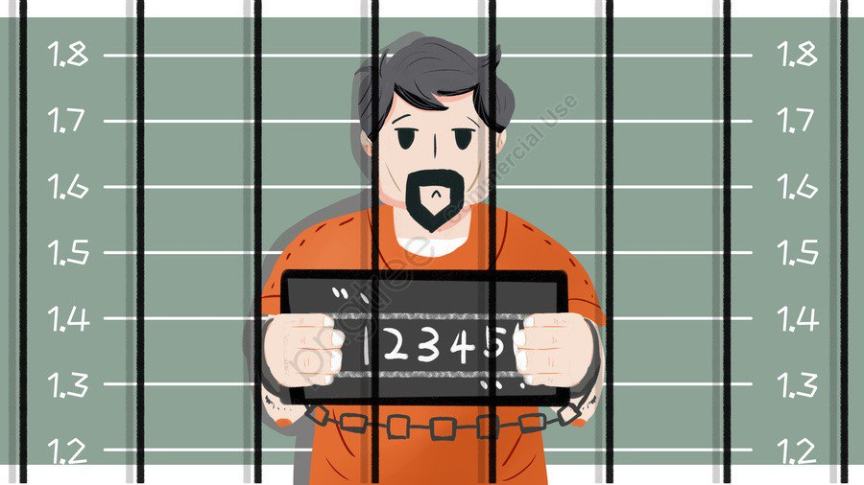
System Overview
The system analyzes legal case texts. It compares new cases with stored case records. It returns the most similar past cases and their decisions.

Slide 5
Text Preprocessing AND Feature Extraction
- Text cleaning and normalization. Tokenization and stop-word removal.
Preparing legal text for machine learning models.
- TF-IDF Vectorization is used. Transforms legal text into numerical vectors.
Captures important legal terms and patterns.

Slide 6
Machine Learning Models
The system uses more than one machine learning model to analyze legal case data.
Common models include Logistic Regression, Support Vector Machines (SVM), and Naive Bayes.
These models are trained on historical cases with known judicial decisions.
After training, the models help predict decisions for new cases.

Slide 7

Case Matching Process
The system receives a new legal case as input.
The case text is transformed into numerical features using TF-IDF.
Similarity scores are calculated between the new case and stored historical cases.
The most similar cases are selected for further analysis and decision prediction.

Slide 8
Decision Prediction , System Output AND User Interface
1) The system predicts the likely decision. Prediction is based on similar past cases. Outputs a numeric or labeled decision.
2) Most similar cases are displayed. Predicted decision is shown. Confidence scores may be included.
3) Simple and interactive interface. Judges upload case text or files. Results are displayed clearly.

Slide 9
Benefits
1) Supports judges by providing fast access to similar past cases and relevant decisions.
2) Enhances consistency in judicial rulings by relying on data-driven case matching.
3) Reduces time and effort required for manual case analysis.
4) Improves transparency by making decision patterns and similarities more visible.
5) Acts as a decision support tool without replacing human judicial judgment

Slide 10
Future Improvements
Integrate more advanced machine learning and deep learning models.
Expand the system to cover multiple legal domains.
Use larger and more diverse judicial datasets to improve accuracy.
Enhance similarity measures for more precise case matching.
Enable integration with official judicial databases.

Slide 11
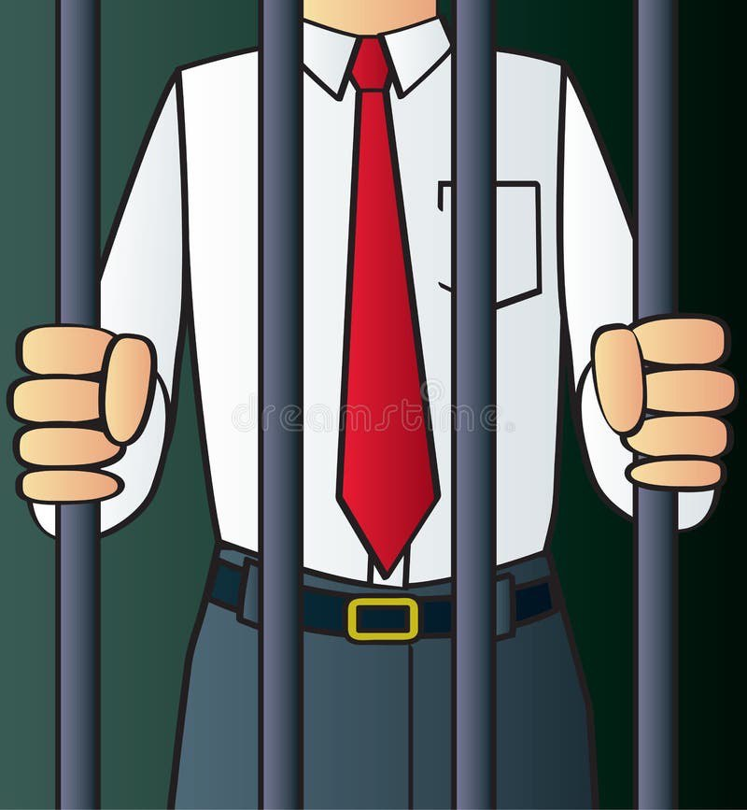
Key Code Components Used in the System :
The following code snippets represent core components implemented in this project, each contributing to the system’s functionality.

Slide 12
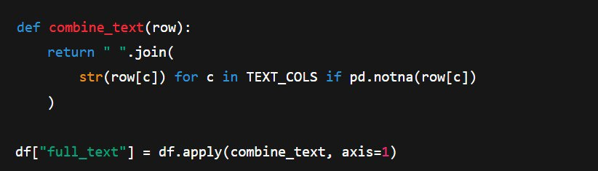
Legal Text Consolidation
This step unifies heterogeneous legal information into a single structured textual representation, ensuring consistent feature extraction across all cases .

Slide 13
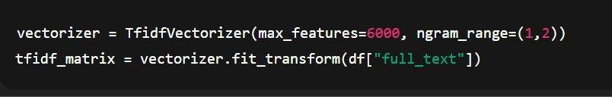
TF-IDF Feature Engineering
TF-IDF is employed to weight legally significant terms while reducing the influence of common, non-informative words, enabling effective case comparison .

Slide 14
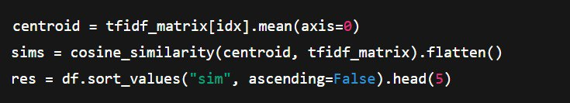
Similarity-Based Case Retrieval
Cosine similarity is used to retrieve the most relevant historical cases by measuring semantic closeness within a high-dimensional legal feature space .

Slide 15
Conclusion
This project demonstrates how machine learning techniques can support judicial decision-making by matching legal cases with relevant precedents while preserving human judgment

Slide 16
Supervisor : dr.enas khashashneh
Team members :
Sara al-Zreigat
Jocelyn al-rabadi
Reham al-rabadi
lana al-rabadi

